Slide 1
Exception Handling

Slide 2
Topics covered
Ode to Errors, Bugs, and Exceptions,
The Role of .NET Exception Handing,
The System. Exception Base Class,
Throwing a Generic Exception,
Catching Exception,
CLR System – Level Exception (System. System Exception),
Custom Application- Level Exception (System. System Exception),
Handling Multiple Exception,
The Finally Block,

Slide 3
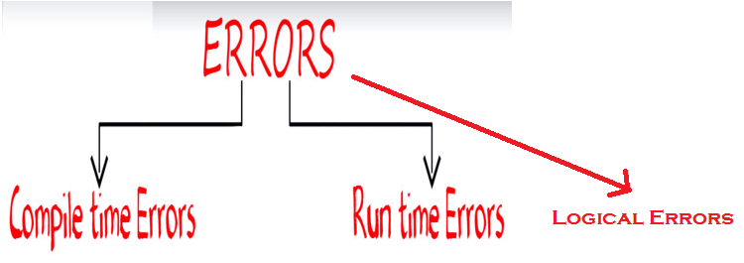
Ode to Errors, Bugs, and Exception
Errors are mistake or abnormal condition it occurs during the execution of the program.

Slide 4
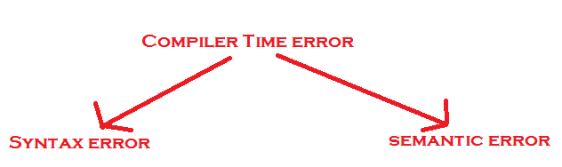
Compile Time Error:
Compile errors are those errors that occur at the time of compilation of the program.
If any error is generated at the time of compilation is known as compile time error

Slide 5
Syntax errors: Syntax errors occur during development, when you make type mistake in code. Or The rules of the programming language are not followed, the compiler will show syntax errors.
Common examples of syntax errors are:
Misspelled variable and function names
Missing semicolons
Improperly matches parentheses, square brackets, and curly braces
Incorrect format in selection and loop statements

Slide 6
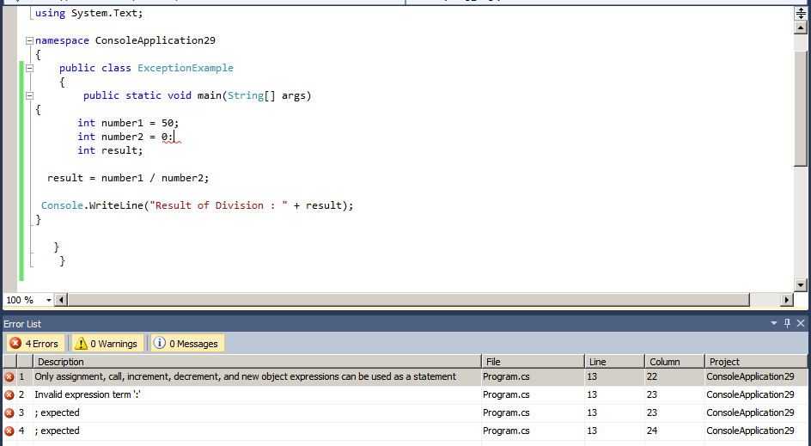

Slide 7
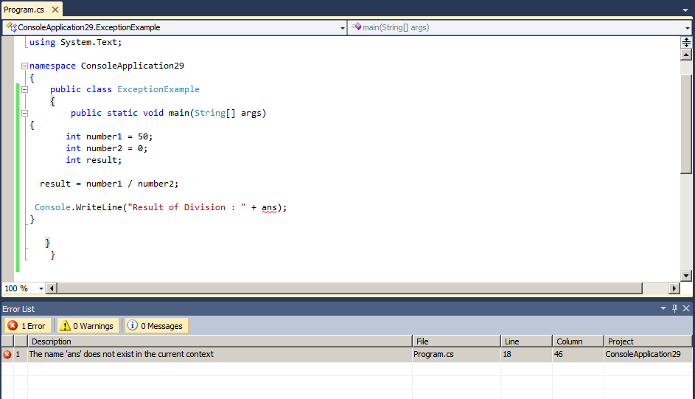

Slide 8
Semantic Errors:
Semantic errors are reported by the compiler when the statements written in the program are not meaningful to the compiler.
Consider the statement b+c=a;

Slide 9
Logical Error:
Program is compile and running successfully but we are not getting the expected output due to not written correct logic.
Also, logical errors could not be detected by the compiler, and thus, programmers have to check the entire coding of a c program line by line.
Example of Logical errors:
Multiplying when you should be dividing
Adding when you should be subtracting
Opening and using data from the wrong file
Displaying the wrong message

Slide 10
Run Time Error:
Runtime errors are those errors that occur during the execution of a program and generally occur due to some illegal operation performed in the program.
Run Time Error is also called as Exception.
Examples of some illegal operations that may produce runtime errors are:
Dividing a number by zero
Trying to open a file which is not created
Lack of free memory space

Slide 11
What is bug?
In the computer world, a bug is a coding error in a software program. It may cause a program to unexpectedly quit or behave in an accidental manner.
What is error?
An error is a term used to describe any issue that arises unexpectedly that causes a computer program to not function properly work. Computers can encounter either Software Errors or Hardware Errors.

Slide 12
What is an Exception?
An exception (or exceptional event) is a problem or error or anomalies or event that arises during the execution of a program.
When an Exception occurs the normal flow of the program is disrupted and the program/Application terminates abnormally.
which is not recommended, therefore, these exceptions are to be handled.

Slide 13
An exception can occur for many different reasons
ArithmeticException.
NullPointerException.
NumberFormatException.
ArrayIndexOutOfBoundsException

Slide 14
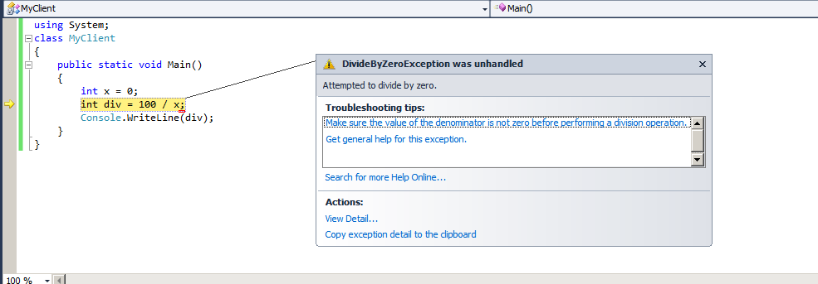
If we divide any number by zero, there occurs an ArithmeticException.

Slide 15
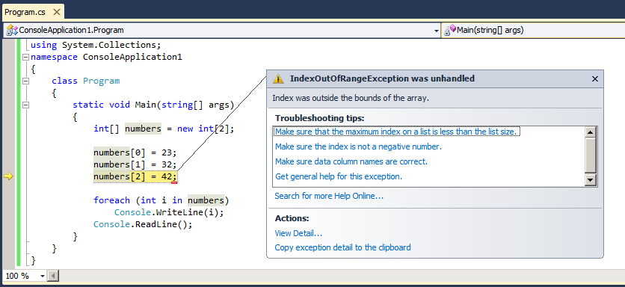
If you are inserting any value in the wrong index, it would result ArrayIndexOutOfBoundsException

Slide 16
NumberFormatException:
The wrong formatting of any value, may occur NumberFormatException. Suppose I have a string variable that have characters, converting this variable into digit will occur NumberFormatException.
String s="abc";
Int i=Integer.parseInt(s);
//NumberFormatException

Slide 17
NullPointerException:
If we have null value in any variable, performing any operation by the variable occurs an NullPointerException.
String s=null;
System.out.println(s.length());
//NullPointerException

Slide 18
Exception in .NET
A .NET exception is an object that describes a runtime error condition.
When a runtime error condition arises, an object is created that represents the runtime error and is thrown in the method that has caused the error.
Whatever may be the way, the exception is caught and processed at some point.
Exceptions can be generated by the CLR or can be generated by the code.

Slide 19
The Role of .NET Exception Handling
Exception Handling is the mechanism of handling exceptions in the program at run time.
We perform exception handling so the normal flow of the application can be maintained even after runtime errors.
The .NET platform provides a standard technique to send and trap runtime errors: structured exception handling (SEH).
C# Contains numerous exception class.
Exceptions are objects that contain a human-readable description of the problem, as well as a detailed snapshot of the call stack that triggered the exception in the first place.

Slide 20
Advantage of Exception Handling
Maintain the normal flow of the application.
why we use exception handling?
Let's take a scenario:
statement 1;
statement 2;
statement 3;
statement 4;
statement 5; //exception occurs
statement 6;
statement 7;
statement 8;
statement 9;
statement 10;
an exception at statement 5, rest of the code will not be executed i.e. statement 6 to 10 will not run. If we perform exception handling, rest of the statement will be executed.

Slide 21
The Atoms of .NET Exception Handling
A class type that represents the details of the exception that occurred
A member that throws an instance of the exception class to the caller
A block of code on the caller’ s side that invokes the exception-prone member
A block of code on the caller’s side that will process (or catch) the exception should it occur

Slide 22
The System.Exception Base Class
An application may encounter an error during the execution.
Exception contains necessary information about the error.
Two types of exceptions in .NET: Exceptions generated by the executing program and Exceptions generated by the CLR.

Slide 23
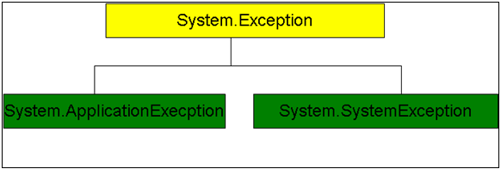
C# includes built-in classes for every possible exception.
All the exception classes are directly or indirectly derived from the Exception base class.

Slide 24
System.Exception is a base class for all CLR generated errors.
ApplicationException is a base class for all application related exceptions.
System.Exception class is a base class for all the exception that can occurs during execution of the program.
No other class derives ApplicationException class by default, because you as a programmer need to derive this class to create your own exceptions classes as per the business rules.

Slide 25
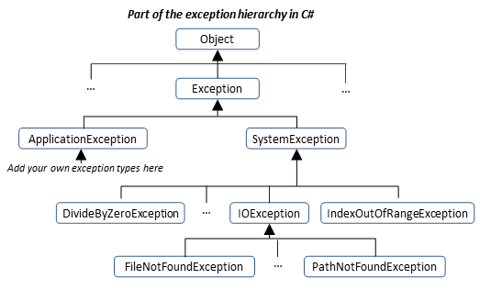

Slide 26
important exception classes available in .Net
ArgumentException: Raised when a non-null argument that is passed to a method is invalid.
ArgumentNullException: Raised when null argument is passed to a method.
ArgumentOutOfRangeException: Raised when the value of an argument is outside the range of valid values.
DivideByZeroException: Raised when an integer value is divide by zero.
FileNotFoundException: Raised when a physical file does not exist at the specified location.
IndexOutOfRangeException: Raised when an array index is outside the lower or upper bounds of an array or collection.

Slide 27
Every exception class in .Net is derived from the System.Exception base class.
System.Exception contains important properties (core members).
These members can be using to get information about the exception when you handle the exception.

Slide 28
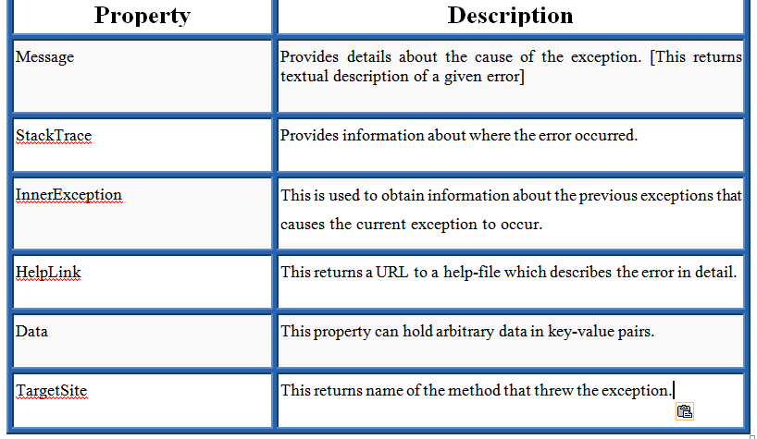
Members (properties)

Slide 29
Exception handling is done using four keywords
try,
catch,
finally, and
throw

Slide 30
try: try keyword is used for identifying code block which may cause exception at runtime.
catch: catch keyword handle the exception if try block raises exception. The code under try block if raises runtime error, try block sends handler to catch block to handle error.
The catch block contains an exception handler and some statements used to overcome that exception
finally: finally block executed whether exception is raised or not. It is used for cleaning resource and executing set of code.
throw: throw keyword is used for creating user defined exception messages.

Slide 31
Syntax
Try
{
//statements that may cause an exception
}
catch(ExceptionType exOb)
{
//Exception Handling Code
}

Slide 32
Try Catch Block syntax
Try
{
//Statement 1;
//Statement 2;
//Statement 3;
}
catch(Exception e)
{
//Exception Handling Code
}

Slide 33
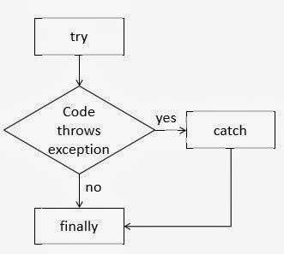

Slide 34
Throwing a Generic Exception
if any exception occurs, we can throw a specific exception such as:
DivideByZeroException
FileNotFoundException
OutOfMemoryException
An exception can be raised manually [or exception are send explicitly] by using the throw keyword.

Slide 37
Catching Exceptions
A catch block contains a code that will process the exception.
When the program throws an exception, it can be caught using “catch” keyword.
Once the exception is caught, the members of System.Exception class can be invoked.
These members can be used to
1) Display a message about the exception
2) Store the information about the error in a file
3) Send a mail to administrator

Slide 40
Handling Multiple Exceptions
A try block can throw multiple exceptions that can be handled by multiple catch blocks. Remember that a more specialized catch block should come before a generalized one. Otherwise the compiler will show a compilation error.
try block can follow multiple catch blocks. if there is a chance of getting multiple exceptions then we go for multiple catch blocks to handle all the exceptions at once.

Slide 41
try
{
statements..
}
catch()
{
statements..
}
catch()
{
statements..
}

Slide 42
Generic catch Statements
C# supports a generic catch block that does not explicitly define the type of exception. That is, we can write:
catch
{
Console.WriteLine(“Some error has occurred”);
}

Slide 43
Rethrowing Exceptions
To re-throw exception, simply make use of the "throw" keyword within a catch-block.
try
{
. . .
}
catch(CarIsDeadException e)
{
throw e
}

Slide 44
The Finally Block
A finally statement must be linked with a try statement.
It identifies a block of statements that needs to be executed regardless of whether or not an exception occurs within the try block.
It means if you write a finally block , the code should execute after the execution of try block or catch block.

Slide 45
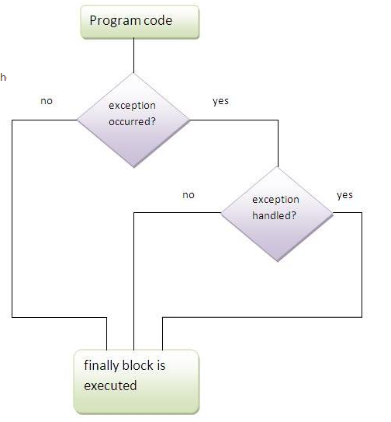

Slide 46
try { //statements that may cause an exception } catch ( … ) { //error handling code } finally { //statements to be executed }

Slide 47
CLR System-Level Exceptions (System.SystemException)
Exception Class can be classified into two types.

Slide 48
C# includes built-in classes for every possible exception.
Example:
→ DivideByZeroException
→ OutOfMemoryException
→ IndexOutOfRangeException etc.
All these exception classes defined by CLR or BCL (Base Class Libraries)
Exceptions thrown by methods in the BCL are called system-exceptions.
System Exception: System Exception is predefined Exception class in C# that is ready to use in programming. Just choose which exception may occur in your code and use it in catch block.
Main idea:, When an exception-type derives from System.SystemException, it can be concluded that the exception was raised by .NET runtime.

Slide 49
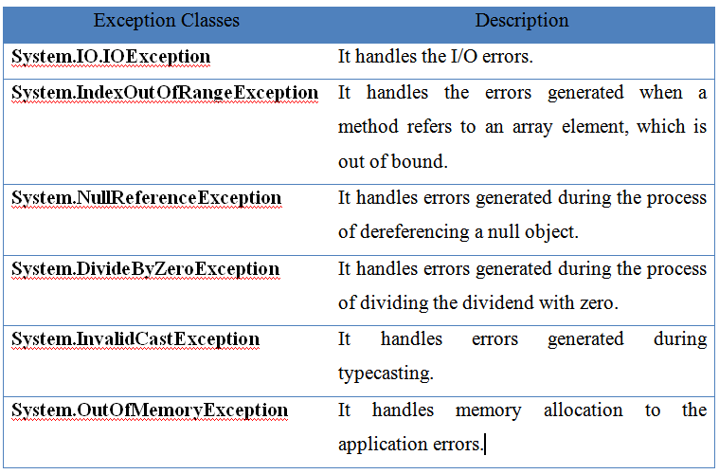

Slide 51
Custom Application-Level Exceptions (System.ApplicationException)
If you want users to be able to programmatically distinguish between some error conditions, you can create your own user-defined exceptions.
An exception that is raised explicitly by the programmer in the application on its own condition is an “Application Exception”.
It can also refer to as a “User Defined Exception”.
Use of throw keyword.
While creating custom exception class it is best practice to keep class name with the end of Exception word.
example, OutofStockException, NumberNotFoundException, IamHeroException etc.

Slide 52
How to develop our own User Defined Exception
1. Inherit a class from the Exception class.
For example:
<Your class> : Exception
2. Override the string message from the exception class.
Public override string Message
{
get
{
Return “Display the error Message when Exception Occur”
}
}
3. if an exception occurs that throws an exception for the creation of an object of your own exception class then do something.
Throws new <Own Exception name>

Slide 53
public class OutofStockException : Exception
{
created a custom exception class OutofStockException which is catches by catch block when user enter larger number than the stock available. All the user defined exception class must be derived from its base class Exception.

Slide 54
public class OutofStockException : Exception
{
public OutofStockException(string message)
: base(message)
{
}
}
All the exception class must have a constructor. However, you may define numbers of constructors based on your requirement. Here only one constructors in a program, easy to understand. This constructors will be used later to throw a string message.

Slide 55
Now in the main method, we asks user for buying a headphone and asks the total number of headphone he/she want to buy. If the number of buying headphone is equal or less than the stock a congratulations message appear but if the total number of buying headphone is larger than stock available it raise OutofStockException.

Slide 56
try
{
if (acceptorder == 10 || acceptorder < 10)
{
Console.WriteLine("Congratulations! You have bought {0} headphones", acceptorder);
Console.ReadLine();
}
else
{
throw (new OutofStockException("OutofStockException Generated: The number of item you want to buy is out of stock. Please enter total item number within stock"));
}
}
catch (OutofStockException oex)
{
Console.WriteLine(oex.Message.ToString());
Console.ReadLine();
}

